Slide 1
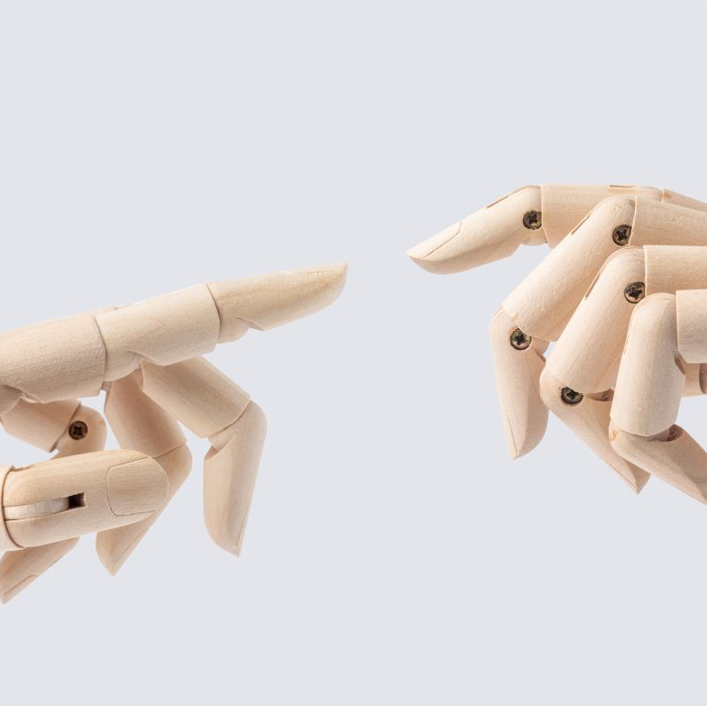
Sign Language Recognition Using Static Gesture Classification
Team Members:
Viraj Bhapkar
Prathmesh Sawant
Shubham Kothawade
Omkar Ranawade
Sanket Shetgaonkar

Slide 2
Abstract
Focus: Recognizing static ASL hand gestures using CNNs.
Approach: Preprocessing (resizing, normalization, augmentation) + Deep Learning.
Outcome: High accuracy for static gestures
Problem Statement
Static gestures (letters/numbers) represent a subset of ASL.
Goal: Build a model to recognize these gestures from images.
Long-term vision: Expand to dynamic gestures and sentence-level recognition.

Slide 3
Existing and Proposed Methods
Existing Methods:
Glove-Based Recognition
Requires wearing specialized gloves to capture hand movements.
High accuracy but limited by environmental conditions (e.g., rain) and portability.
Vision-Based Recognition
Relies on static or dynamic image/video capture.
Static captures hand gestures as images.
Proposed Method:
Utilize vision-based recognition with static image datasets of ASL alphabets.
Leverage deep learning (CNNs) for feature extraction and classification.

Slide 4
Dataset Description
Details
Classes: 26 (A–Z).
Images: RGB, resized to 200x200 pixels.
Preprocessing: Resizing, normalization, data augmentation (rotation, flipping, zooming)
Limitations
Overlapping Gestures: Similar letters (e.g., "M" vs. "S") cause misclassification.
Static Dataset: Cannot represent motion-based gestures like "J" or "Z."

Slide 5
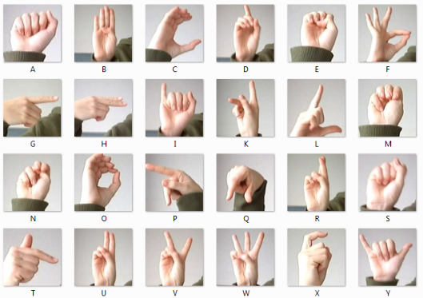
Dataset preprocessing

Slide 6
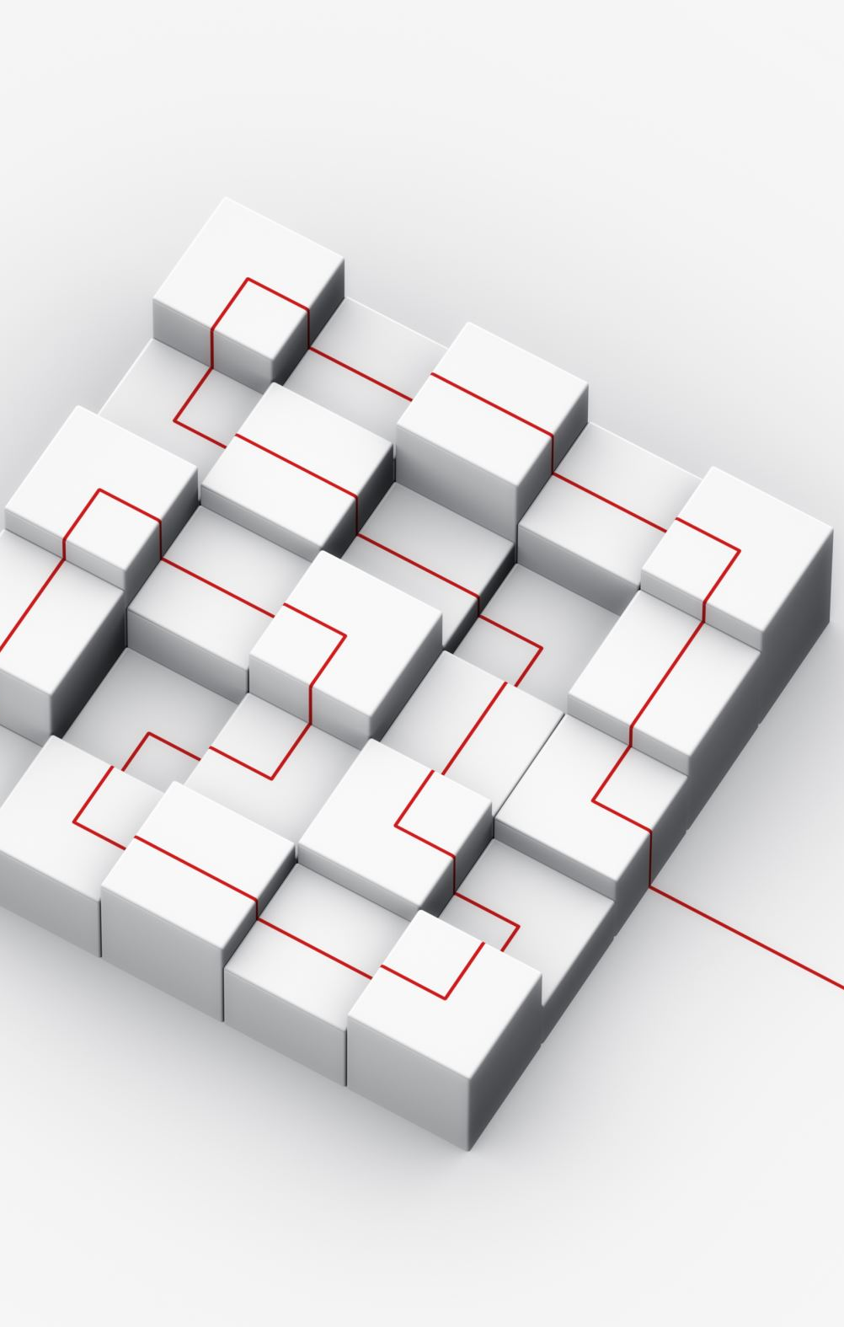
Methodology
Model Architecture
CNN Layers: Extract spatial features (edges, shapes).
Pooling Layers: Reduce dimensions while retaining key information.
Fully Connected Layers: Perform classification (A–Z).
Transfer Learning
Used InceptionV3 (pre-trained on ImageNet).
Added custom layers for ASL classification.
Benefits: Faster training, robust feature extraction.

Slide 7
Training Process
Data Split
80% Training, 20% Validation.
Hyperparameters
Learning Rate: 0.001.
Batch Size: 32.
Epochs: 25.
Loss Function and Optimizer
Loss Function: Categorical Cross-Entropy.
Optimizer: Adam (adaptive learning for faster convergence).
Key Steps
Preprocessed images using resizing, normalization, and augmentation.
Trained model with real-time validation to monitor performance.

Slide 8
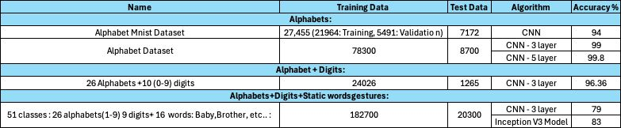
Results

Slide 9
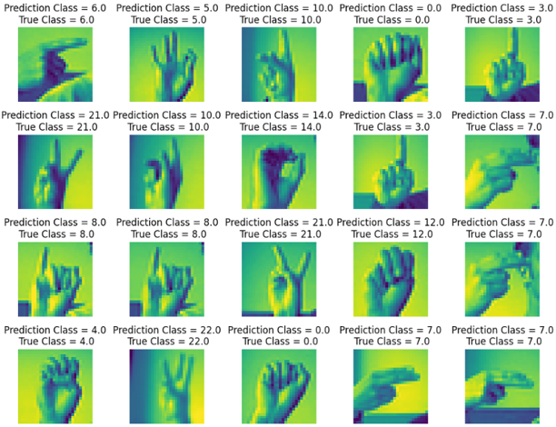
Results

Slide 10
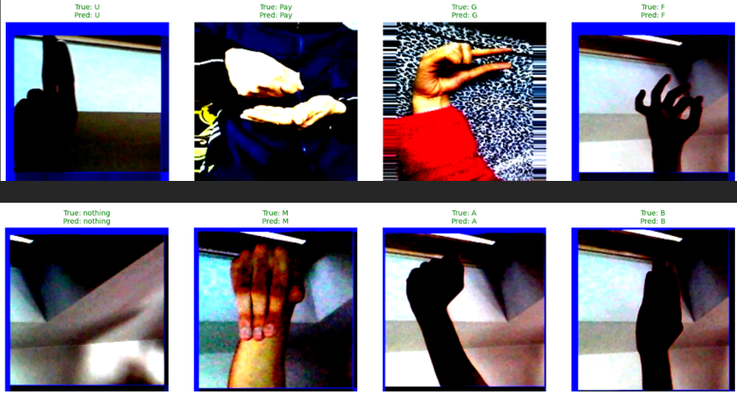
results

Slide 11
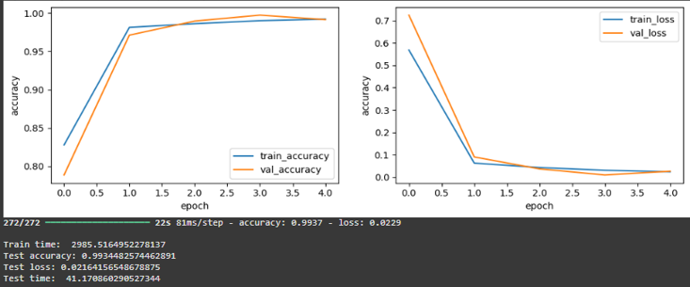
results

Slide 12
Thank You

